Slide 1
Comparing Micro-Macro Dynamics and Control Across Social-like Systems Using Equation Free Modeling
James R. Watson
DARPA YFA 2017-2019
Assistant Professor, Oregon State University
email: jrwatson@coas.oregonstate.edu
web: jwatson.ceoas.oregonstate.edu/

Slide 2
Summary
Overarching Goal: Identify general and recurring micro-macro dynamics across social-like systems, focusing on new early-warning signals (EWSs) of large and abrupt change.
Objective: Develop new mathematical framework for observing and modeling social-like systems based on equation-free / geometric methods. Use this framework to identify and learn about new and general EWSs.
Statement Of Work (SOW), Milestones M1-6:
M1 (get data)
M2 (advance and perform new Manifold / Geometric Data Learning methods)
M3 (develop multi-scale models of social like systems)
M4 (experiment, and develop new EWSs/prediction)
M5 (account for uncertainty and risk, identify computational limits and provide fast approximations)
M6 (new methods of control, expand applications)
Observe in new ways
Year 1
Year 2
Model &
Experiment
Year 3
Learn &
Improve

Slide 3
Year 1 - Observe in new ways
Goal: *Observe* multiscale phenomena in social-like systems in new ways: through manifold / geometric data learning
Objectives: Advance new methods from manifold and geometric learning for examining multi-scale patterns in social-like systems, starting with cutting edge techniques — diffusion maps and spectral graph wavelets.
SOW: Achieve the following milestones:
M1 (get data);
M2 (advance and perform new Manifold / Geometric Data Learning methods);
start M3 (start modeling social like systems)
Expenditures: Hired 2 post-docs, bought laptops and a server, traveled to DC numerous times, hosted collaborators from Princeton and Japan for hackathons and made DoD site-visits.
>10% underspent: we are ~9% underspent as it took time to hire the right post-docs. Now we are spending at the expected rate and are on track.

Slide 4
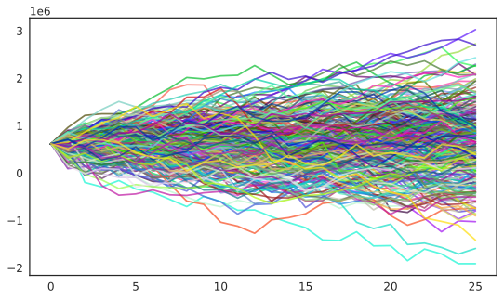
Year 1 - Observe in new ways
Accomplishments:
Synthesized all data for social-like system case-studies (and more)
Developed new use of diffusion maps with application to collective behavior in fish (paper in review at PNAS) and financial markets
New advance to spectral graph wavelets with application to human mobility data (paper in review at PNAS)
Mathematical advances for new methods for multi-scale analysis: wavelet maps (one math preprint published, another on the way)
Developed another new use of diffusion maps with application to predicting El nino and housing market crashes (2 paper in prep)
New multi-scale observational capabilities
Observational methods:
e) repeat over time and anticipate large change
a) get data
b) construct graph
c) perform manifold learning
d) examine shape
Notes:
Methods in a nutshell
a) Collect (timeseries) data on the micro-scale agents comprising the social-like system of interest; b) construct graph representations of the interactions between agents from these data; c) perform manifold learning using methods like diffusion maps or spectral graph wavelets; d) summarize the *shape* of your data; e) repeat this as new data comes online, doing so provides early warning of large and abrupt regime change.
Transition and broader impacts
Connections have been built to numerous new collaborators: USC ISI, NGS2, A-teams, SPAWAR
I have obtained additional funding from NASA to implement YFA tools for predicting illegal activities at sea ($860K, 3-years)
I have started a company: The Prediction Lab LLC, for applying these new methods for real-world problem solving. Currently we are doing so for the City of Salem OR, for predicting harmful algal blooms in the source of their drinking water.

Slide 5
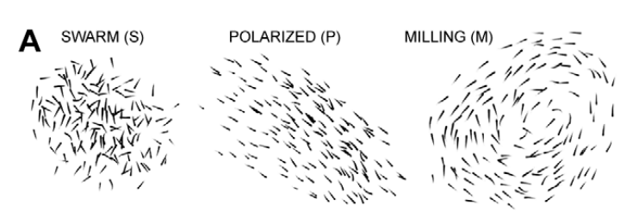
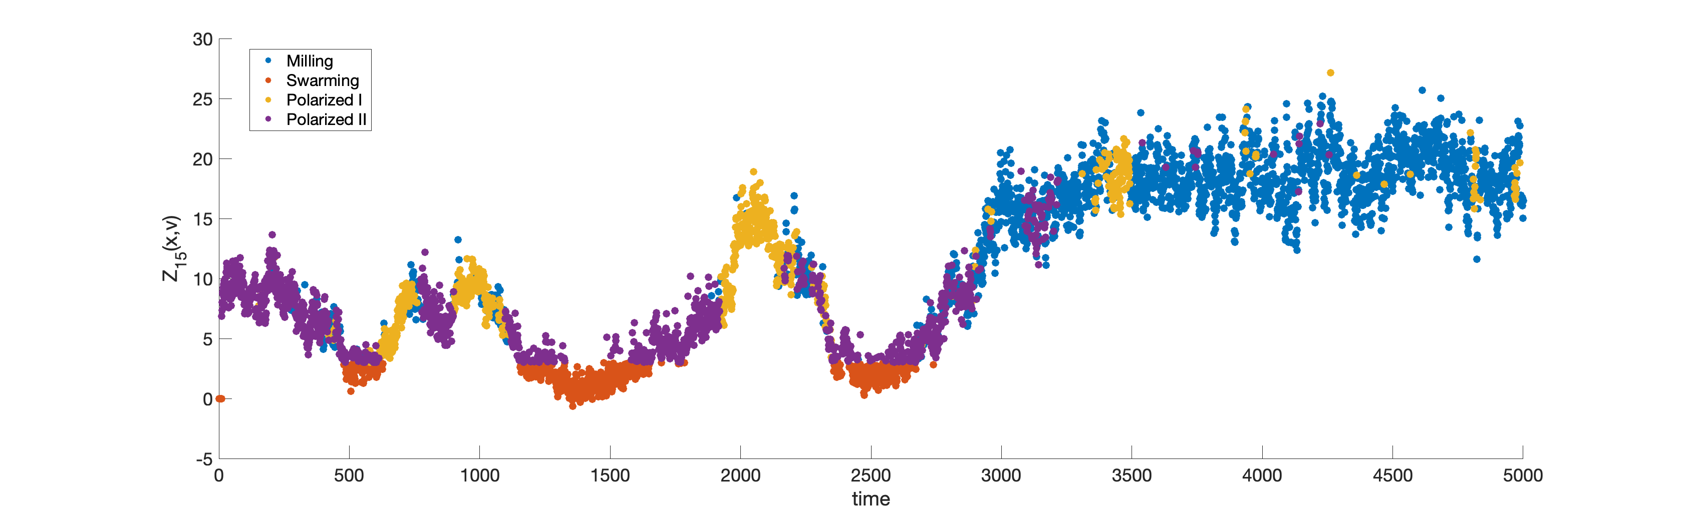
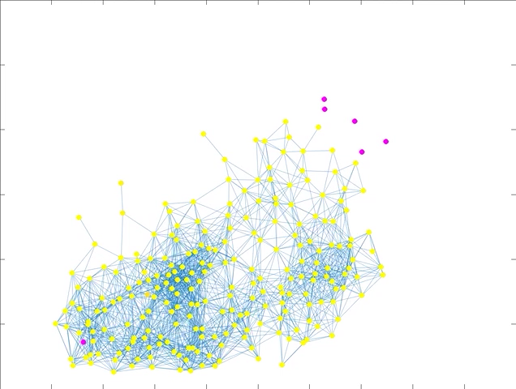
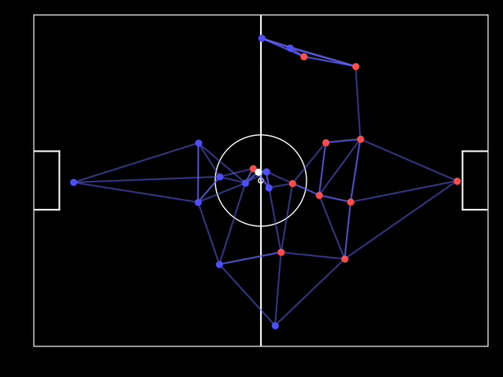
Year 1 - Observe in new ways
A) changes in system geometry over time can be used to identify regime shifts
New measure of system geometry
B) “Leader” agents that drive change can be identified
A) This has utility for teams
Notes:
Results
A) measures of a system’s geometric (in this case a fish school) can be used to identify different regimes or modes; B) individual agents creating regime change can be identified (early) and C) while these initial results were made using biological collectives, these tools can be widely applied, for example to competitive sports teams.

Slide 6
Year 2 - Model and Experiment
From Year 1: developed bleeding edge multi-scale data analytic methods to *observe* changes in the geometry of social-like systems.
Yr2 Goal: this observational ability is new; now we are in the process learning *why* we see what we do through the lens of geometry
Objectives:
most important is to model social-like systems to link geometric patterns to general mechanisms driving multiscale change
continue to apply new data analytic tools to empirical datasets to maximize research output (i.e. numerous papers are lined up)
Statement of Work:
Milestone 3 — develop multi-scale models of social-like systems, focusing on voter models of contagion, probe consistent utility of new geometric methods for predicting regime change
Milestone 4 — use model to experiment and verify new EWSs/prediction; in addition work with NGS2 performers (Penn) game-theoretic simulations and models to predict innovation

Slide 7
Year 2 - Model and Experiment
Core Anticipated products:
General model of social-like systems where equations and multiscale closures are known (from our own model, and that of Penn/NGS2)
New social-like system theory of multi-scale change based on geometry, developed using new model (leading to peer-reviewed pub)
Create new multi-scale early-warning signals and methods (wavelet maps) to quantify influence and identify leaders (and their followers) in collectives (peer-reviewed pub)
Maintaining Productivity:
Continued application of geometric data learning methods (three peer-reviewed papers expected):
hysteresis of human mobility (focusing on Senegalese flooding in Dakar);
geometric early-warning signals of El Nino;
classifying the causes of the 2007 housing market crash
Extending Utility:
Geopolitical Femtorisks: conceptual paper to be submitted to Science describing *Femtorisks*, the seemingly small and inconsequential actions by a few actors that create cascading effects (co-funded by project on illegal activities at sea)
Knowledge transfer: application of new tools to DARPA A-teams and Sigma+ programs, and in collaboration with NAVY/SPAWAR

Slide 8
Year 3 - Learn and Improve
Observe in new ways
Model &
Experiment
Learn &
Improve
Year 1
Year 2
Year 3
Year 3 is a vital step to completing the scientific investigation of geometric early-warning signals of multi-scale change in social like systems
SOW (at the full cost of $392,381 for year 3)
Hire additional researcher (George Hagstrom at Princeton, expert in the modeling and analysis of complex systems)
Complete modeling and experimentation to verify generality of new geometric multi-scale methods / understanding
Develop new methods for controlling social-like system: using geometric representations of social-like systems, develop new methods that *nudge* systems to different states.
Account for uncertainty: often there is uncertainty in graph structure used to represent social-like systems. To account for this, we will embed our geometric methods in a Bayesian framework.
Identify computational limits and fast approximations: our new geometric methods can be computationally demanding, which is a bottle neck for transition. To overcome this we will rigorously determine the computational limits (scalability, performance with sparse data) and create fast approximations.
Confirm generality
Confirm utility for transition
Notes:
Key insight/innovation, scientific/technical impact:
Control: by learning how to control social-like systems through small nudges, we will also be able to identify when a social-like systems is being controlled (by an adversary)
Uncertainty: posing our geometric prediction methods in a Bayesian framework will give us explicit bounds on our forecast abilities, and as a consequence allow us to estimate risk, a crucial step for transition

Slide 9
Year 3 - Learn and Improve
Relation to original goals:
The end-goal is to identify general and recurring multi-scale early-warning signals of large and abrupt change in social-like systems. Without year 3, our YFA results will remain pathological to the case studies analyzed. This is still important and useful, but Yr3 is key to confirming the generality of our new geometric EWSs and their utility for transition to DoD applications.
Potential defense application(s):
Predicting illegal activities at sea (new 3yr project underway funded by NASA and in collaboration with the Navy)
Aid in the design, management and destruction of teams (potentially working with the DARPA A-teams program)
Early-warning signals of innovation by terrorist groups (potentially working with the DARPA SIGMA+ program).
Predicting patterns of human migration (relevant to an ongoing MINERVA project overseen by Lisa Troyer)
Identifying hidden adversaries from the anomalous spatial response of living marine organisms from acoustics (whitepaper submitted to the Persistent Aquatic Living Sensors [PALS] program at DARPA)
Technical merit/strengths:
The *shape* of a system can be identified using Topological Data Analysis. However, Geometric Data Learning is new, and additionally aids in the understanding of the processes governing dynamics of social-like systems (i.e. its not just observational)
Accounting for uncertainty, defining the computational limits (and fast approximations) and advancing control theory are critical innovative steps to the overall utility of these new methods.

Slide 10
Year 3 - Learn and Improve
Potential concerns:
For year 3, accounting for uncertainty and implementing new approaches to control might be computationally unfeasible, for real-time or near real-time applications.
Risk mitigations and costs:
If so, we will work with small/medium sized (but important) systems, and identify heuristics (i.e. polynomial approximations) for scaling up the application of our geometric methods to larger systems. Importantly, year 3 itself is risk management for the overarching goal of the project, providing time to complete and expand on the necessary modeling and experimentation, especially in terms of the collaboration with NGS2 performers
SOW (at 50% cost we will maintain current team)
Complete modeling and experimentation to verify generality of new methods. Even at 50% funding we will complete this phase of the project (this is crucial)
Account for uncertainty: often there is uncertainty in graph edges used to represent social-like systems. At 50% funding we will perform an initial application of a Bayesian version of our geometric methods to create a roadmap for determining prediction bounds and a broader ability to deal with uncertainty
Identify computational limits: the limits to the new geometric methods need to be identified. At 50% funding we will focus solely on polynomial approximations for scaling methods up to large graphs.
At 50% funding we will *not* be able to explore new control theory for social-like systems

Slide 11
YFA Products to Date
Publications
Monk, Christopher T., et al (including Watson JR as a co-lead author). "How ecology shapes exploitation: a framework to predict the behavioural response of human and animal foragers along exploration–exploitation trade‐offs." Ecology letters 21.6 (2018): 779-793.
Gelbaum et al. “Multi-Scale Analysis on Complex Networks using Hermitian Graph Wavelets”, ArXiv Pending*.
Titus et al. “System Rattle as an Early Warning Signal of Regime Change in Complex Systems”, ArXiv Pending*.
Publications in review:
Watson et al. “Manifold Learning of the Dominant Modes of Human Mobility”. PNAS (in review)
Titus et al. “Unsupervised Manifold Learning of Collective Behavior”. PNAS (in review)
Commercialization:
The Prediction Lab LLC (a technical consultancy that employs these new DARPA methods: secured contract with the City of Salem to predict harmful algal blooms in the source of their drinking water)
Highest ranked ecology journal
Mathematical preprints
Main year 1 deliverables
Broader Impacts
Notes:
*Note about ArXiv publications… they were submitted Monday 21st 2019, and will be online and active with a DOI on Wed Jan 23rd. I will send an updated ppt with links then.

